Slide 1
Factors and Group Dynamics of
US Stock Returns by PCA
Team Member
Danni Deng
Kexin Fei
Mengling Liu
Rui Chen

Slide 2
Agenda
Recap of problem statement
Data preprocessing
Exploratory data analysis
PCA analysis on historical stock data
Findings from PCA analysis
Next steps
Challenges

Slide 3
Recap of problem statement
Goal:
Explore the cross-correlation of equity returns between stocks in a portfolio traded in the financial market
Search of empirical evidence about the existence and nature of common economic factors which drive the time evolution of stock prices
Technique: Principal Component Analysis
Value: Find out interpretable financial factors and effectively improve factor model’s ability to model stock portfolios
Notes:
We mainly focus on exploring the cross-correlation of equity returns between stocks, and search the important economic factor in the stock market. Which brings the value of defining interpretable financial factors and effectively improve factor model’s ability to model stock portfolios.

Slide 4
Data preprocessing
Data sources: Selected dataset contains stratified sample data of 1072 stocks, comprising 75% of Russell 1000 index component stocks and 35% of Russell 2000 Index component stocks. Data set is sampled proportional to percentage composition of each industry.
Russell 1000 Index (Ticker: RUI): an index measuring ~1,000 of the largest companies in the Russell 3000 Index, which is made up of 3,000 biggest US stocks. Comprises ~90% of the total market cap of all listed US stocks
Russell 2000 Index (Ticker: RUT): an index measuring ~2,000 small-cap companies in the Russell 3000 Index. A benchmark for small-cap stocks in the US
Final dataset:
one data set shows trading performance across past 5 years totaling 843 stocks (Mar.2013 - Mar.2018)
another data set shows trading performance across past 15 years totaling 628 stocks (Mar.2003 - Mar.2018)
Notes:
For the first step of data pre-porcessing, we decided the composition of our data set. The companies that we chose are 75% of Russell 1000 (around 900 companies) and 35% of Russell 2000. Both are sampled proportional to percentage composition of each industry.
And they together made up our full data set that contains 1072 stocks.
Moreover, we have two duration for our dataset, one is for five years, and the other one is in 15 years. The reason behind is we wanted to include the financial crisis periods on one hand so we take 15 years; on the other hand, when we were exploring the data, we found out that many companies are listed less than 15 years such as twitter and facebook and SIX FLAGS ENTERTAINMENT CORP. etc., so we decided to take another duration of 5 years.
After all these aboving procedures, the final dataset are one across 5 yrs totalling 843 stocks, and the other one is across past 15 years totalling 628 stocks.

Slide 5
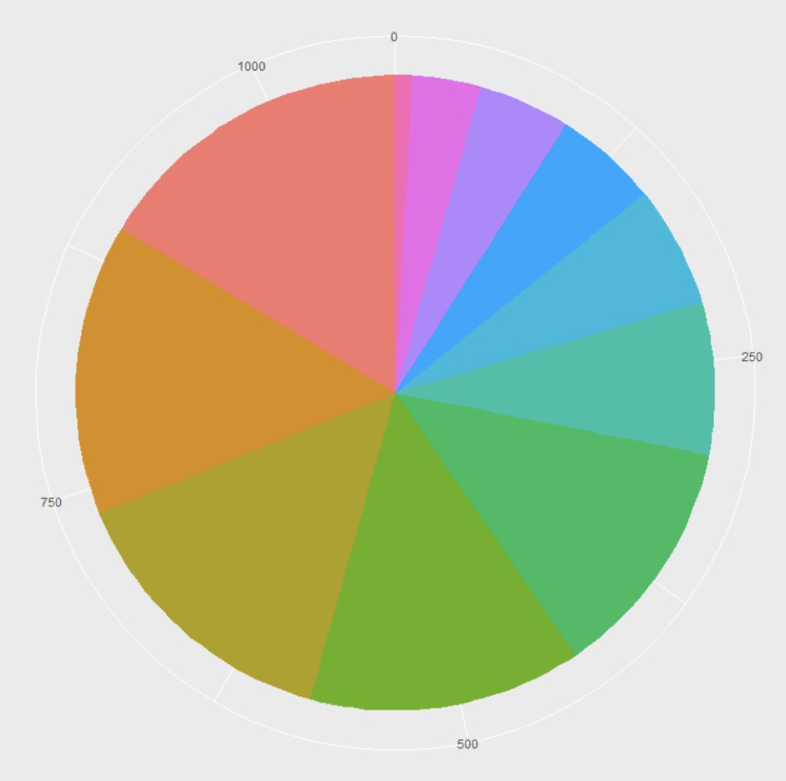
Data preprocessing (continued)
Stock composition by industry
 | Total | Percentage
Financials | 175 | 16.4%
Consumer Discretionary | 159 | 14.9%
Information Technology | 155 | 14.5%
Industrials | 148 | 13.8%
Health Care | 132 | 12.3%
Real Estate | 83 | 7.8%
Energy | 66 | 6.2%
Materials | 56 | 5.2%
Consumer Staples | 50 | 4.7%
Utilities | 37 | 3.5%
Telecom | 9 | 0.8%
Utilities
3.5%
Consumer
Staples
4.7%
Financials
16.4%
Materials
5.2%
Energy
6.2%
Consumer
Discretionary
14.9%
Real Estate
7.8%
Health Care
12.3%
IT
14.5%
Industrials
13.8%
Notes:
This is our stock composition (1072) by industry. Where financials, consumer discretionary, IT, Industrials and health Care, that made up ~ 70% of our data set.
consumer discretionary(considered non-essential by consumers)
Industrials(include heavy manufacturing, light manufacturing, food processing, oil refining and energy production.)

Slide 6

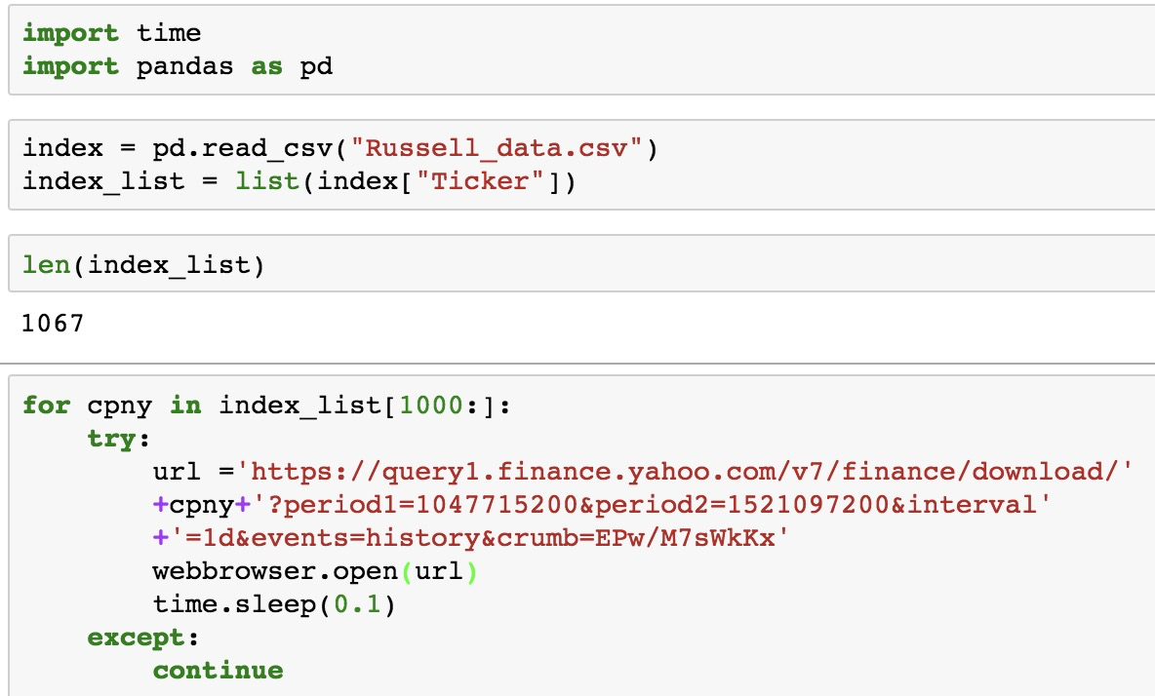
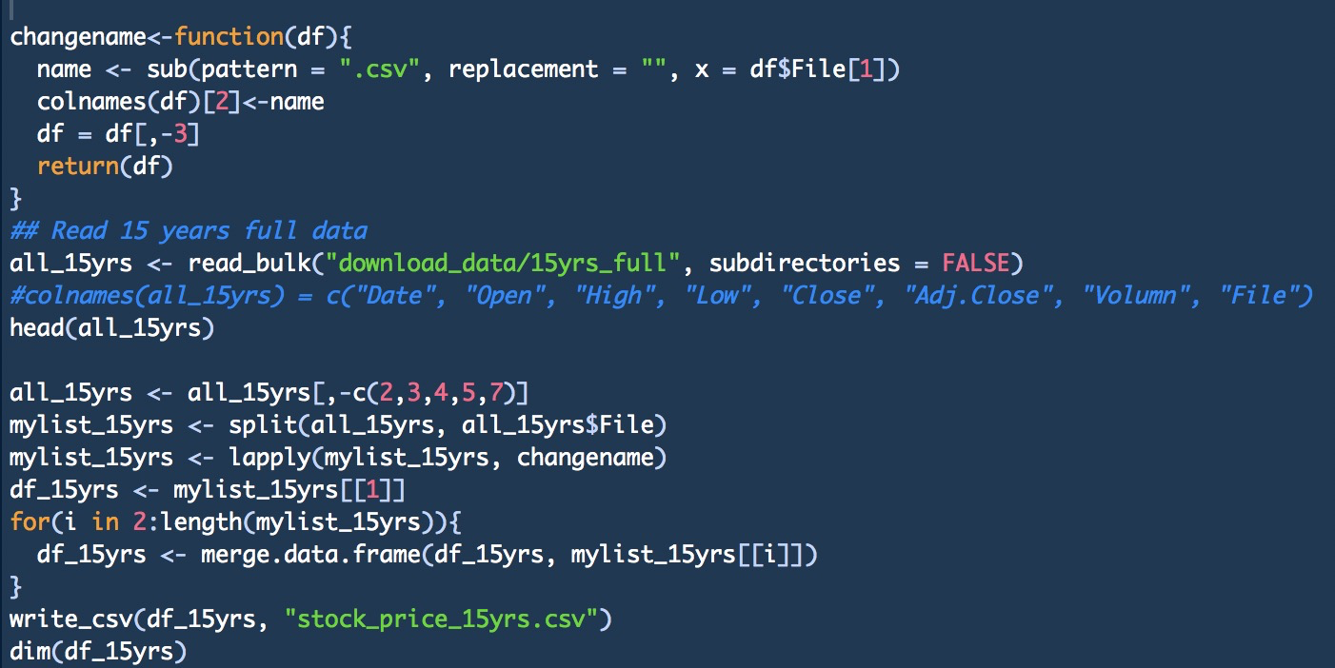
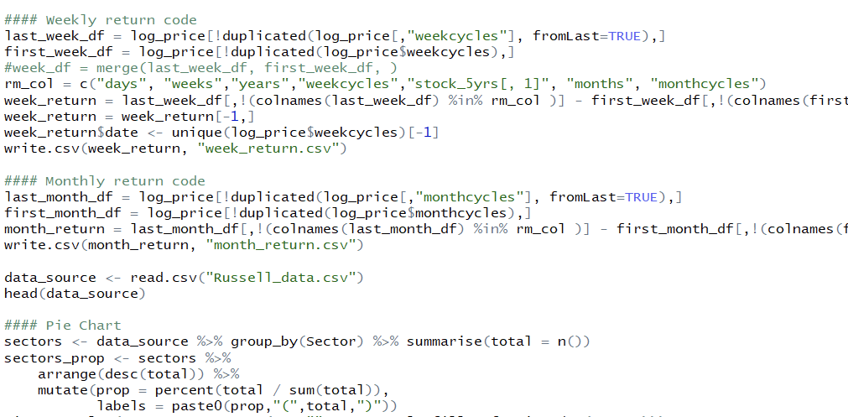
Data preprocessing (continued)
Obtain data
Merge data
Clean data
Automate the web scraping process to obtain past 15 year stock price for 1072 stocks on Yahoo finance website
Merge the 1072 individual csv files into a master table, and then subset the data separately into 5-year and 15-year
Calculate daily, weekly and monthly log return for 5-year and 15-year to prepare for PCA analysis
Notes:
To Summary, first we obtained data by automate the web scraping
Observations are time series, and features are log returns of stock companies.
Reasons for doing 15 years and 5 years

Slide 7
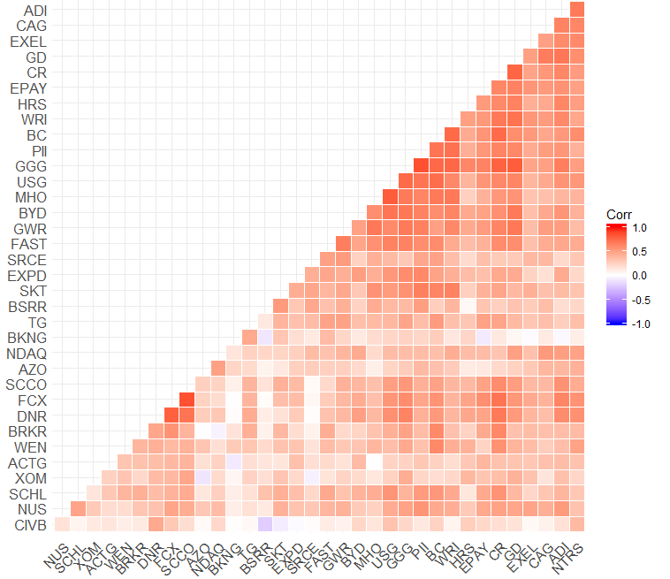
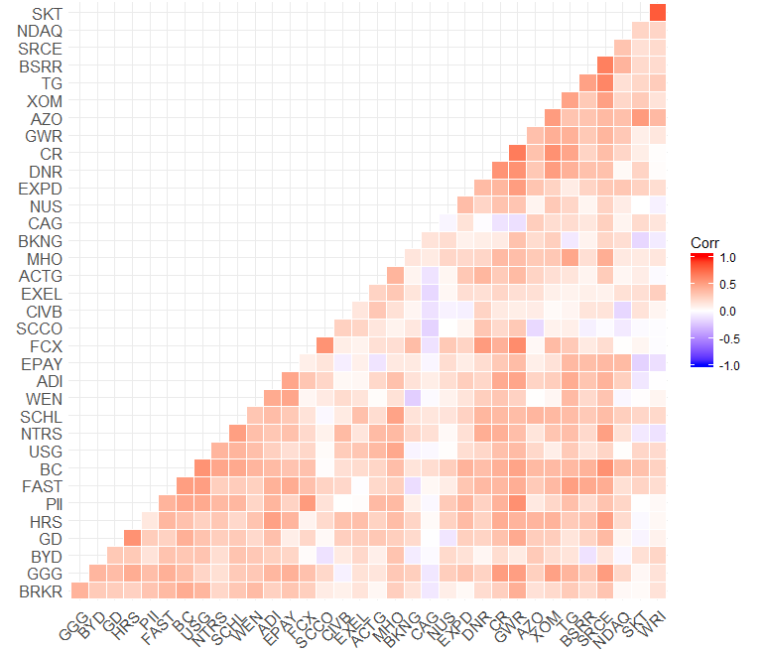
Exploratory data analysis
Market correlation increased in bear markets
Key message:
Equity prices are more highly correlated during financial crisis compared to recent bull market
Markets become more tightly coupled in volatile periods
Correlation Heat Map of Monthly Log Return During Financial Crisis (2008 Jan - 2012 Dec)
Correlation Heat Map of Monthly Log Return in Recent Five Years (2013 Mar - 2018 Mar)
Notes:
In the first step of EDA, randomly choose 35 stocks out of over 1000 stocks during financial crisis and the recent 5 years separately, calculate the monthly return and cross correlation matrix and then plot the correlation heat map of monthly log return
The financial crisis heat map apparently look redder and shows stronger correlation
We also tried weekly return correlation heat map and It gives us the similar result.

Slide 8
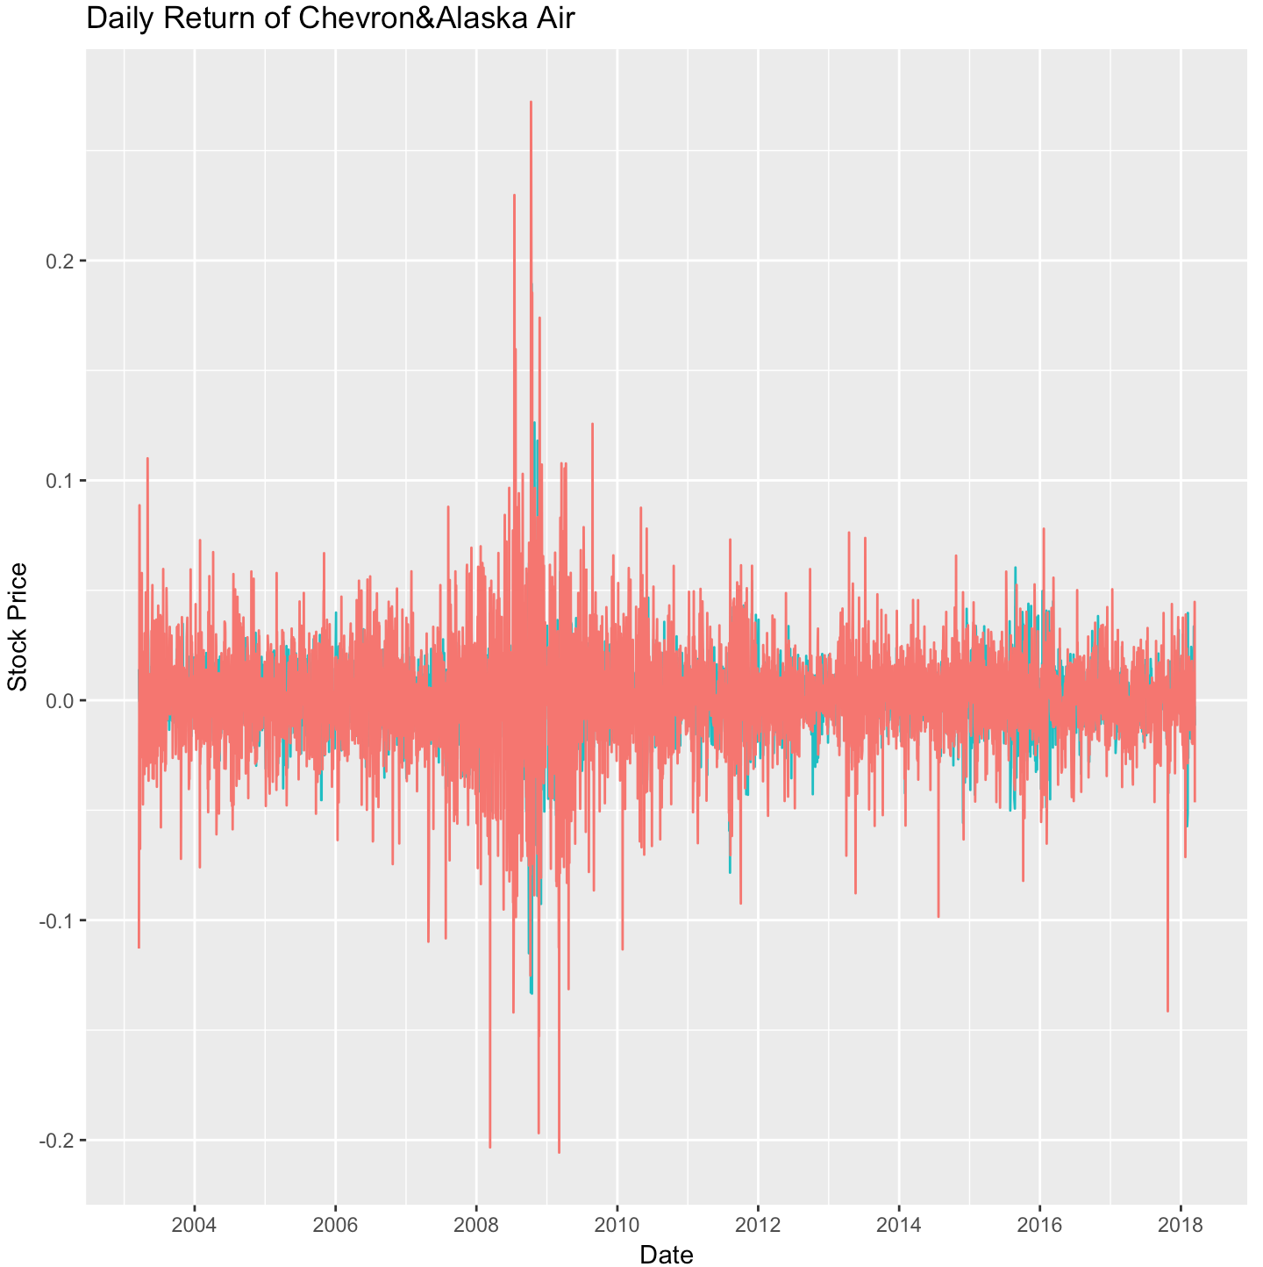
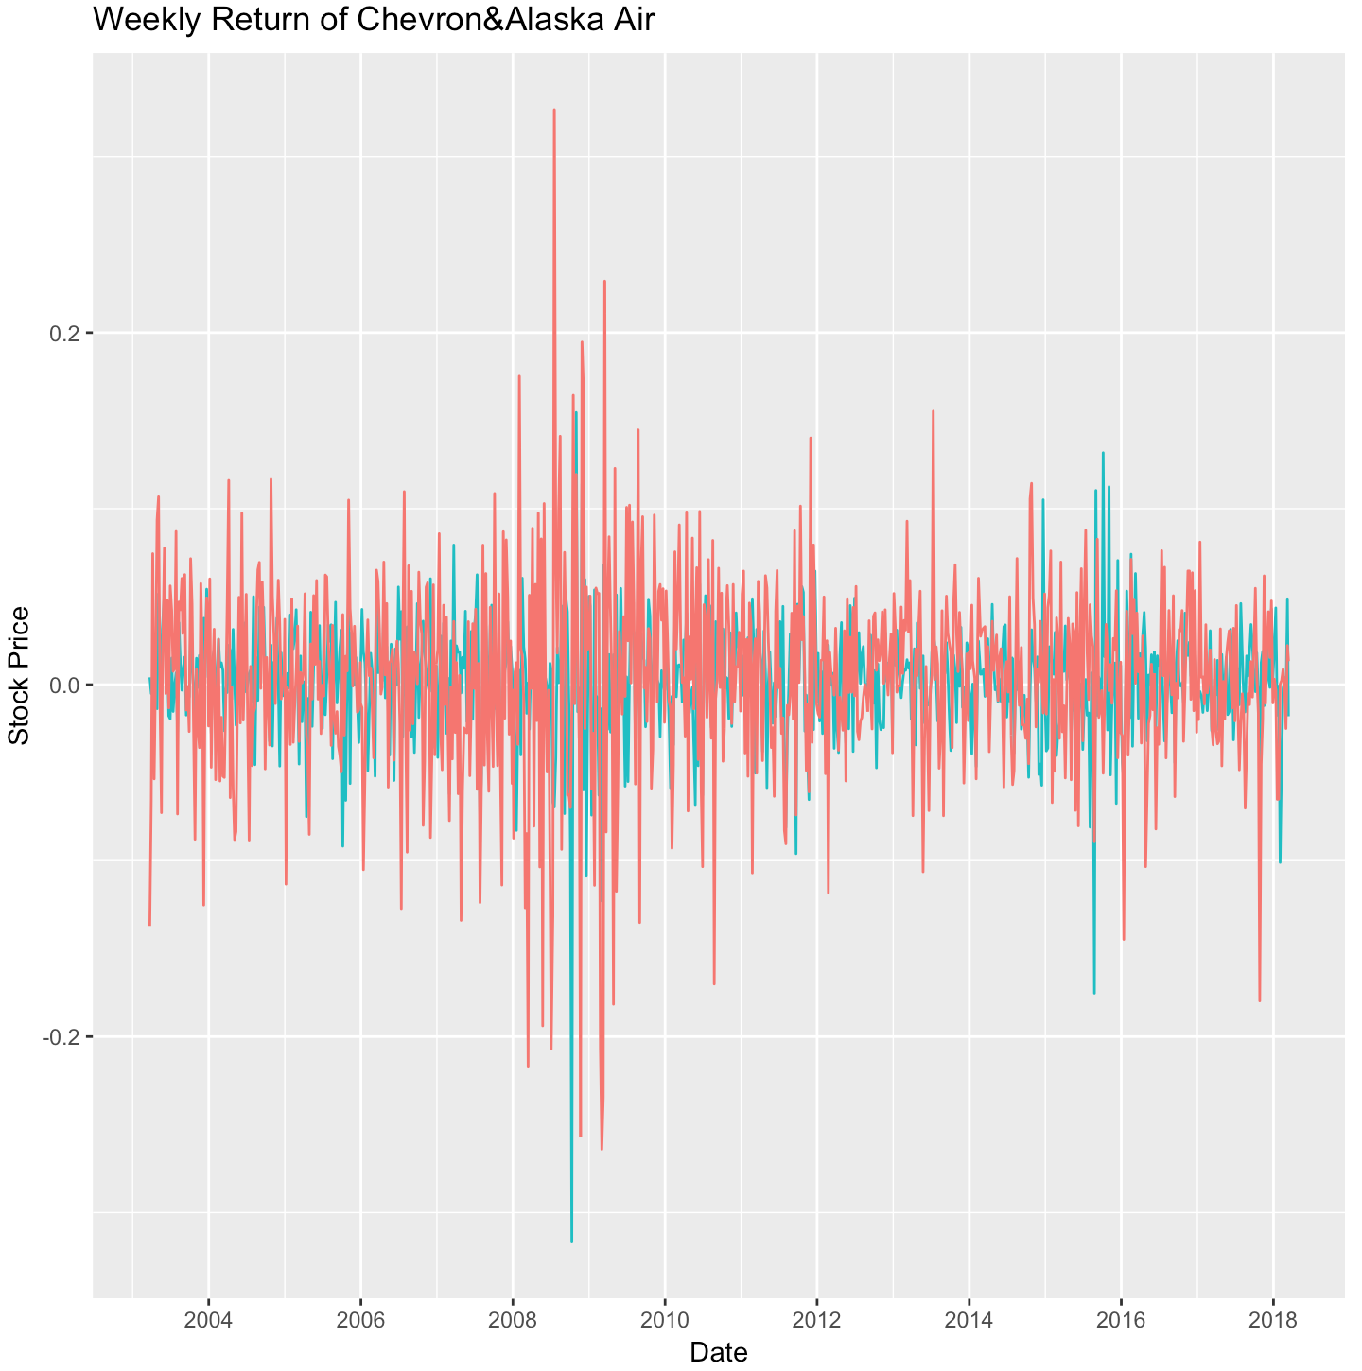
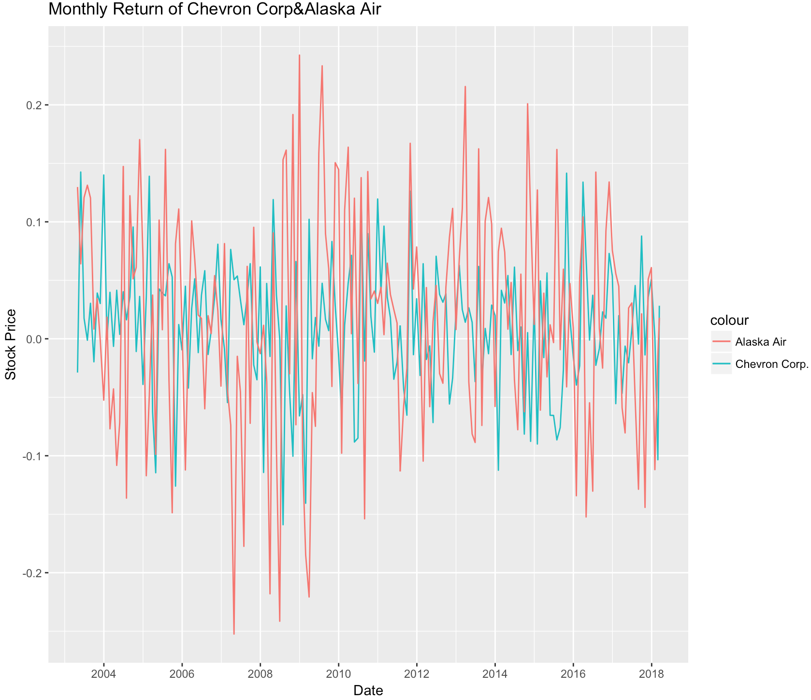
Exploratory data analysis (Chevron & Alaska Airline 2003-2018)
Daily Return(Cross Correlation:0.229)
Weekly Return (Cross Correlation:0.185)
Monthly Return (Cross Correlation:-0.021)
Key message:
Biggest variation happened during stock market crash of 2008. During the financial crisis, the stock market dropped 90%
Compared to Daily and weekly return, monthly return is relatively stationary with more constant variance
The cross correlation coefficient of monthly return on Alaska Air and Chevron is negative, which meet the expectation that airline companies benefit from oil price slump
Notes:
1.Here we selected two stocks(chevron and alaska airline) to conduct EDA. In the first part we use 15 years log daily, weekly and monthly return data which included the 2008 financial crisis period. We could see the two stocks were volatile both in daily and weekly return plots which is noisy. And the biggest variation happened during stock market crash of 2008. During the Great Depression, the stock market dropped 90%.Until 2018, it was the largest point drop in history.
2. From the 3rd plot, monthly return is relatively stationary with more constant variance compared to Daily and weekly return.
3. And that’s consistent with mathematical calculation of the cross correlation between these 2 stock price time series. From daily, weekly, to monthly, the cross correlation is decreased from 0.229 to negative 0.02. Because we expect that airline companies benefit from oil price slump so that airline and energy industries should have negative correlation with each other, which can be represented in monthly return plot.

Slide 9
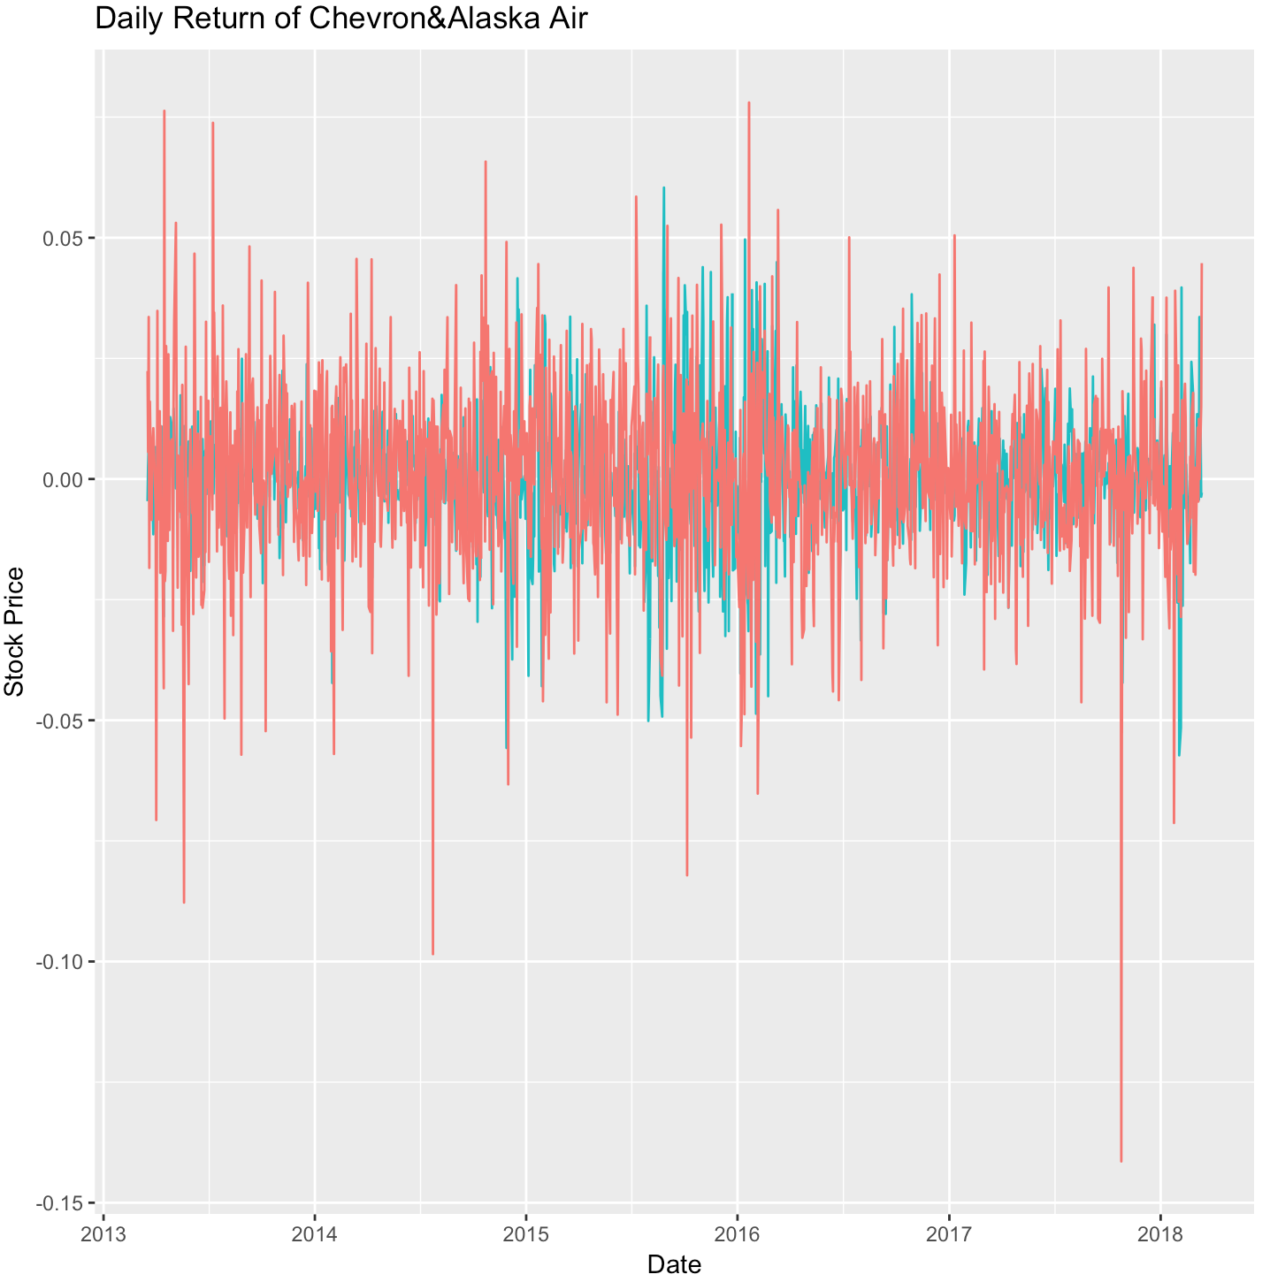
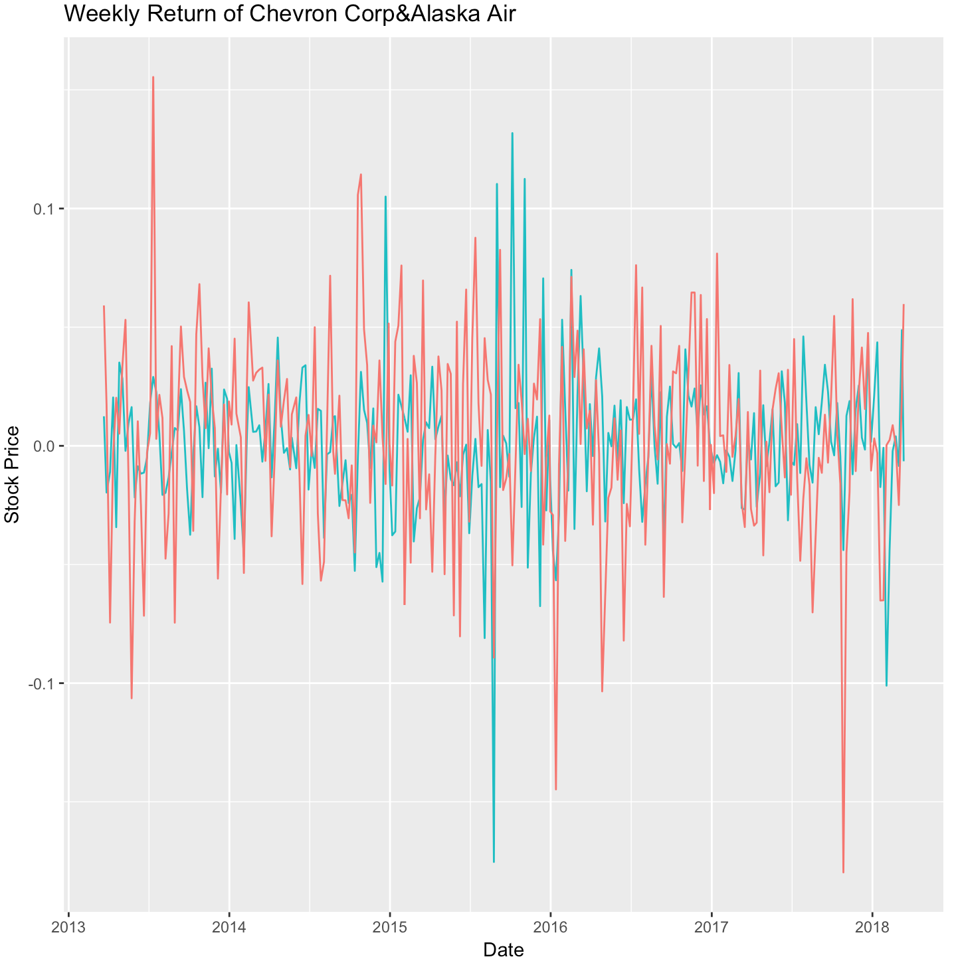
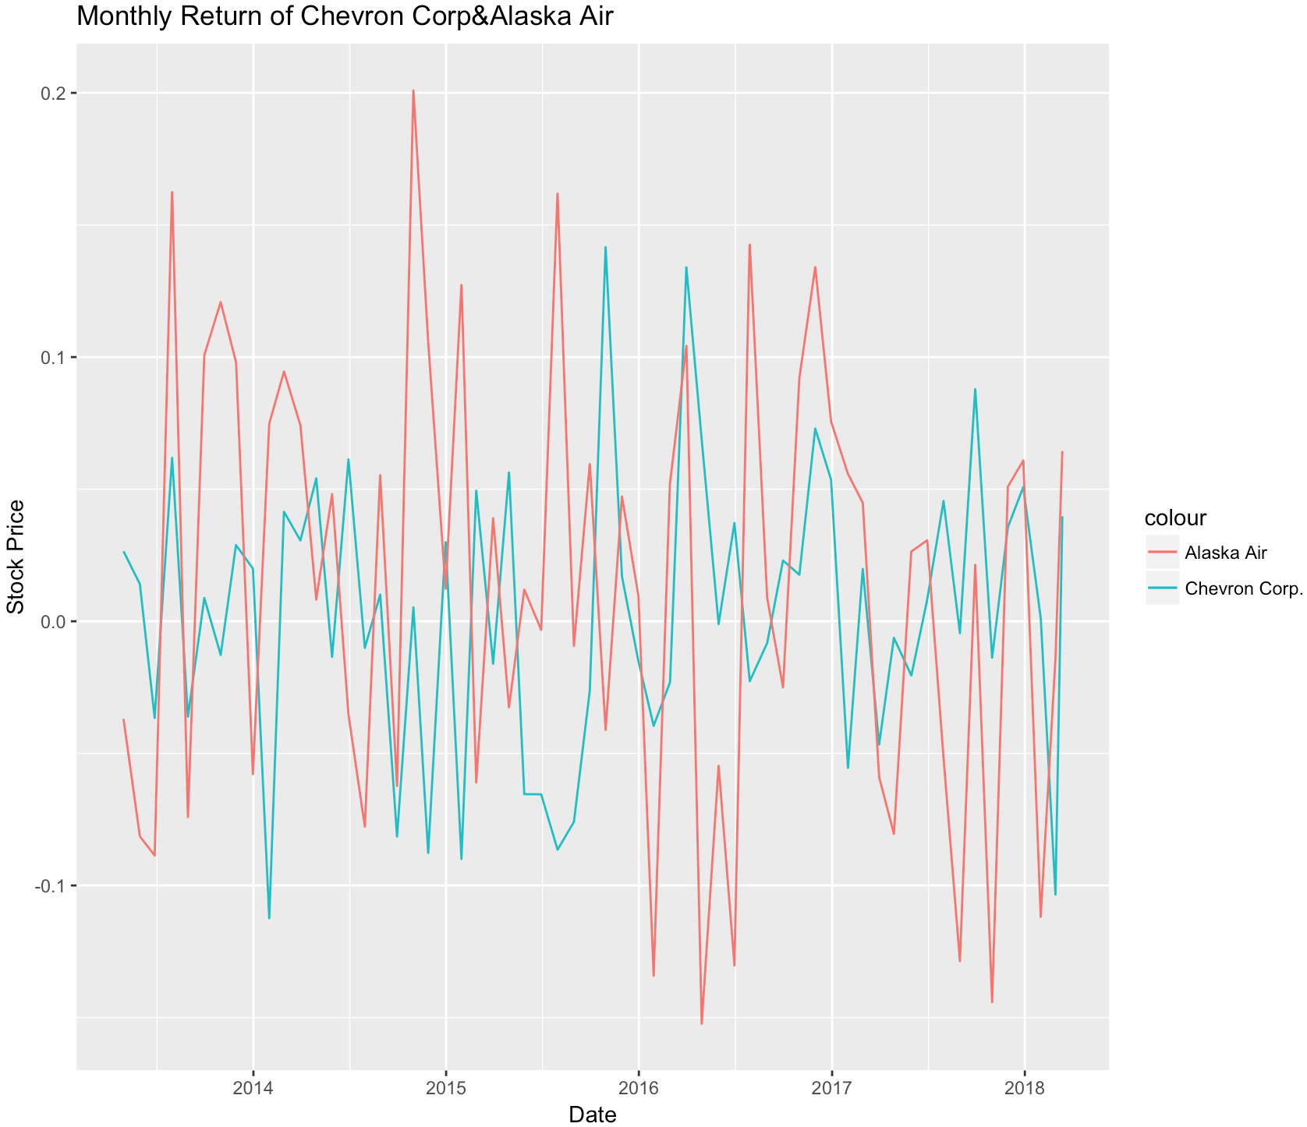
Exploratory data analysis (Chevron & Alaska Airline 2013-2018)
Daily Return(Cross Correlation:0.140)
Weekly Return (Cross Correlation:0.168)
Monthly Return (Cross Correlation:-0.019)
Key message：
The general trend of return is much more stationary during 2013-2018 compared to 15-years stock market
The biggest drop happened in 2015-16 stock market selloff, resulted from China's stock market crash that began June 2015
Monthly return is more stationary with negative cross correlation coefficient and apparently opposite stock price trends.
Notes:
Here we shorten the time window to recent 5 years. Compared to 15 years stock market, the recent 5 years general trend of return is much more stationary
The biggest drop in these plots happened in 2015-16 stock market selloff, one of the possible reasons is the long-term monetary shortfall in Greece and Greek default on June 30, but the decisive trigger was China's stock market crash that began that same June.
Monthly return is more stationary with negative cross correlation coefficient and apparently opposite stock price trends. Based on all eda results, Therefore, we will primarily focus on 15 years data and monthly return to perform PCA.

Slide 10
PCA analysis on stock return
What is PCA?
PCA is a statistical method of dimension reduction that is used to reduce the complexity of a data set while minimizing information loss.
Each principal component is a linear combination of the original variables
The coefficients of principal components indicate the relative importance of the variable in the component.
Why PCA?
Decompose interrelated stocks into uncorrelated components that are composed of weighted stocks
Extract influential financial factors with component loadings in PCA biplots, i.e. market wide effect, idiosyncratic principal components, and the remaining principal components indicate randomness in the fluctuations
How to use PCA?
Perform PCA on daily, weekly and monthly log returns of all stocks
Create scree plots to visualize the percentage of variation explained by different principal components.
Graph the variables (stocks) on different principal components and extract insights, i.e. What factor represents the first PC most closely?
Notes:
A translation of your higher-level, subject questions from 1. (which were stated in `plain English’) into (testable) statistical model statements and formulae. I.e., an expression of the problem into `math’ (stats/machine learning) ~1 page
PCA is a statistical method of dimension reduction that is used to reduce the complexity of a data set while minimizing information loss. It transforms a data set in which there are a large number of interrelated variables into a new set of uncorrelated variables, the principal components, and which are ordered sequentially with the first component explaining as much of the variation as it can. Each principal component is a linear combination of the original variables in which the coefficients indicate the relative importance of the variable in the component.

Slide 11
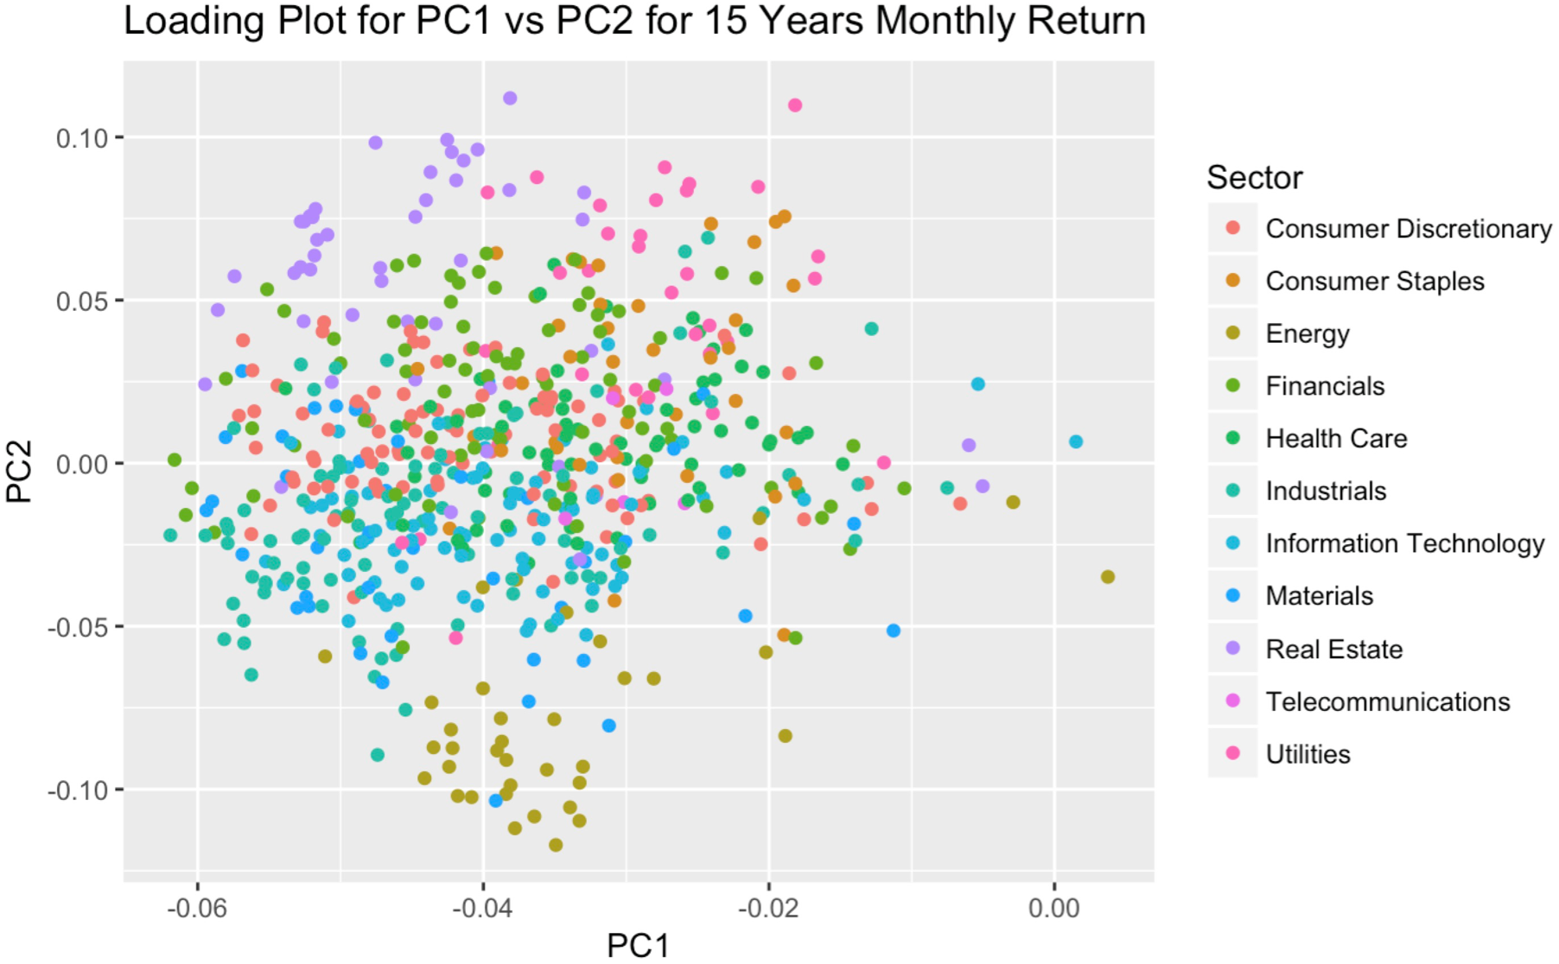
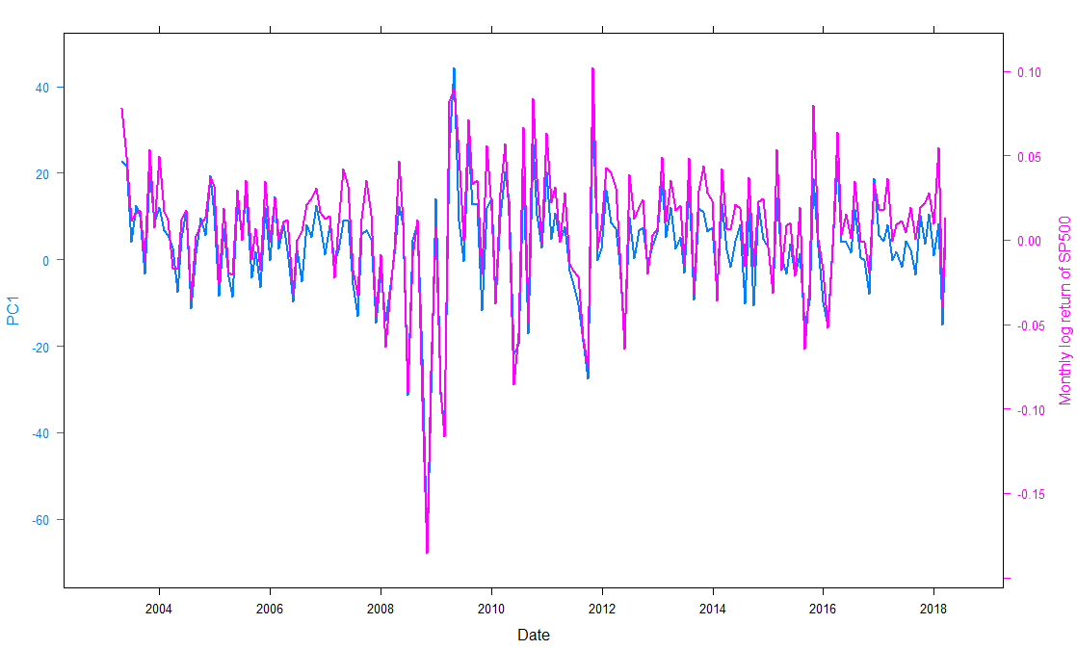
Findings from PCA analysis
Plot of PC1 vs. monthly log return of S&P 500 Index (15yr)
Key message for PC1 for 15 year data set:
The 1st PC represents a market wide effect that influences all stocks
The 1st PC has relatively homogenous negative coefficients across all stocks
PC1 can explain the fluctuation of overall market sentiment for 15 years
Correlation between PC1 value and 15-year S&P 500 index level are strong. Correlation = 0.95
Notes:
5 years - rently 5 years(2013 Mar - 2018 Mar)

Slide 12
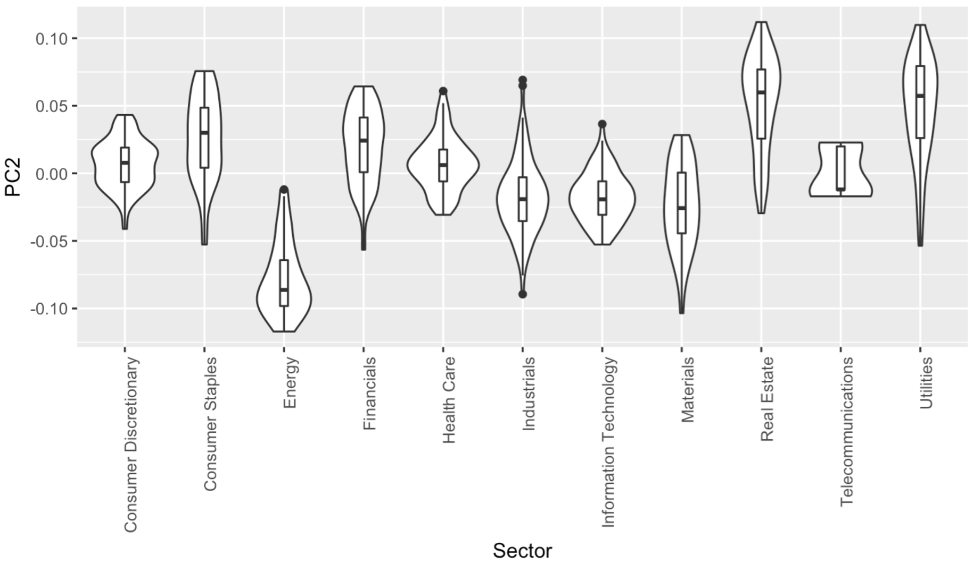
Findings from PCA analysis (continued)
Violin plot of PC2 Loadings by Sector
Key message on PC2 for 15 years data set:
The 2nd PC indicates grouping by sector
Highest positive contribution from real estate, utilities and consumer staples sectors
Negative contribution mainly originates from energy sector

Slide 13
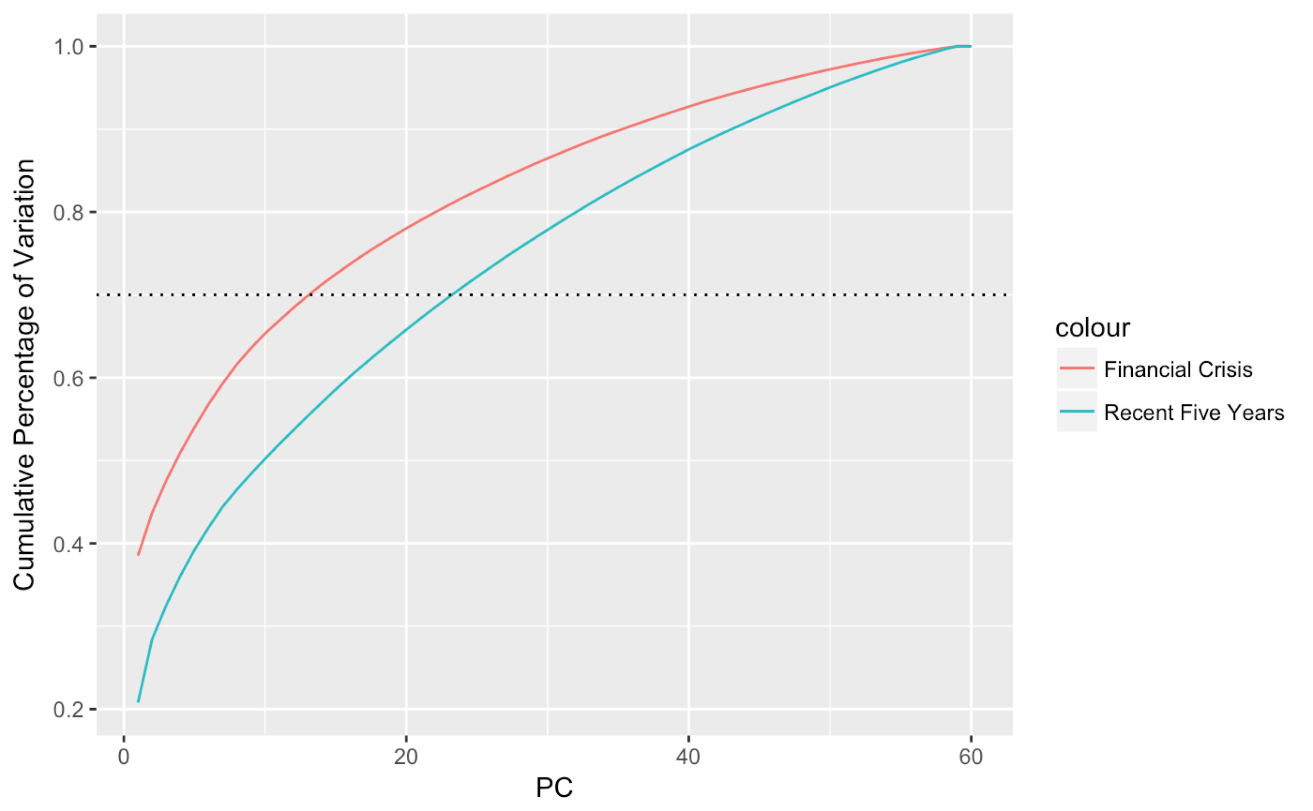
Findings from PCA analysis (continued)
Financial crisis vs. recent bull market
Key message:
For financial crisis period (Jan 2008 - Dec 2012), 23 PCs are needed to explain 70% variance, while the recent 5-year bull market (Mar 2013 - Mar 2018) only requires 13 PCs to explain the same variance
More common variation recorded in the stock market during financial crisis and the market was more concentrated
Market correlation increased in bear markets, same results as the EDA

Slide 14
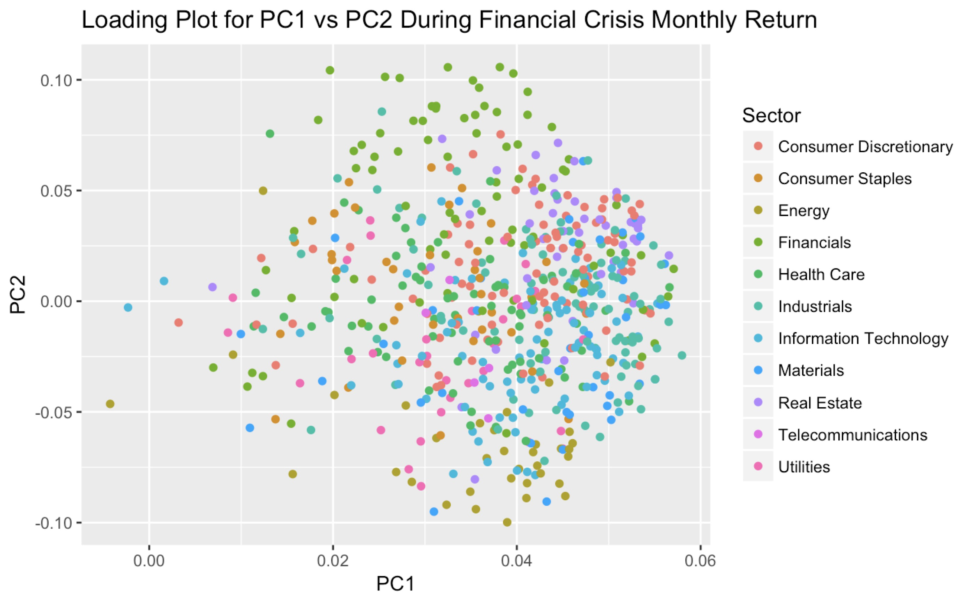
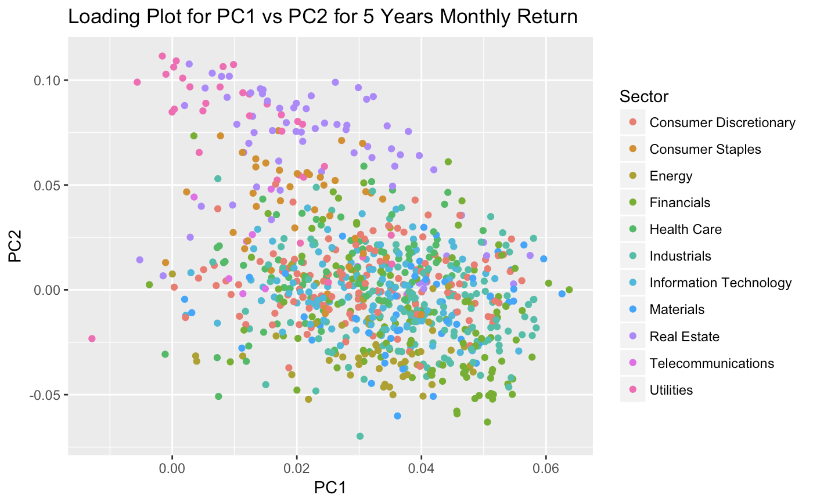
Findings from PCA analysis (continued)
Financial crisis vs. recent bull market
Key message:
Energy sector is relatively more robust than other sectors during financial crisis
In recent five years, real estate and utilities contribute significantly to the second PC but no obvious contributions during the financial crisis period
During financial crisis, points from all sectors are more scattered than recent five years

Slide 15
Next steps...
Explain other principal components i.e. PC3, PC4, etc representing synchronized fluctuations that only happens to a group of stocks
Use PCA technique to reduce equity metrics for stock selection
The main task of feature extraction is to select or combine the features that preserve most of the information
Potential input variables include:
Valuation measures: price/book, PE ratio, etc
Profitability: profit margin, operating margin, etc
Management effectiveness: return on assets, return on equity, etc
Income statement: revenue per share, quarterly revenue growth, etc
Balance sheet: dividend, total debt/equity, book value per share,etc
Trading information: price, volume, market cap,etc
Data source: quarterly data for past 5 years, web scraping from yahoo finance

Slide 16
Challenges
Challenges Encountered:
Understand the application of PCA analysis to financial factor models
Automate the data downloading process of 1000 stocks and combine into user-friendly data table
Correlation between PC1 value and market return index is relatively weak (loading coefficient for PC1 for 15-year is negative)
Challenges Anticipated:
Download financial ratio and economic data for each equity (eg, ￼return on assets,￼ return on equity, ￼revenue per share, book value per share)
Visualization of PCA: hundreds of stocks in one plot with unclear labels, may need to split into subplots
Notes:
Some preliminary results from 3., including challenges encountered or anticipated. ~2 pages

Slide 17
Reference
Bonanno G., Caldarelli G., Lillo F., Micciche S., Vandewalle N., and Mantegna R. N.(Jan 16, 2004). Networks of equities in financial markets
Hargreaves,C. & Mani C. (Aug 9, 2015). The Selection of Winning Stocks Using Principal Component Analysis
Lee J. & Nobi A.(Mar 2, 2015). State and group dynamics of world stock market by principal component analysis
Mantegna R.(Feb 24, 1998). Hierarchical Structure in Financial Markets
Yang, L. (2015). An Application of Principal Component Analysis to Stock Portfolio Management
Notes:
Some preliminary results from 3., including challenges encountered or anticipated. ~2 pages

Slide 18
Thanks!

